Slide 1

19CSE353
Mining of Massive Datasets
CASE STUDY
IMDB Movie Review Analysis
Review - 1
Date: 09 May 2023

Slide 2

Team Members
Avantika Balaji - CB.EN.U4CSE20309
Kowshikraja T R - CB.EN.U4CSE20331
Sanjay Balaji P - CB.EN.U4CSE20354
Archana Ganapathy - CB.EN.U4CSE20407
Gokul S - CB.EN.U4CSE20420

Slide 3
Table of Content
Problem Statement
Dataset
Real-World Application
Sub Problem 1
Sub Problem 2
Sub Problem 3
Sub Problem 4
Sub Problem 5

Slide 4

Problem Statement
The objective of this data mining case study is to analyze the IMDB movie review dataset and extract valuable insights and patterns from the textual reviews. The goal is to uncover meaningful information about the sentiments, opinions, and characteristics of movies based on user reviews.
We intend to use various algorithms specifically related to data mining to - extract keywords, find similar reviews, find duplicate reviews, identify frequently reviewed movies and count positive and negative sentiments.

Slide 5
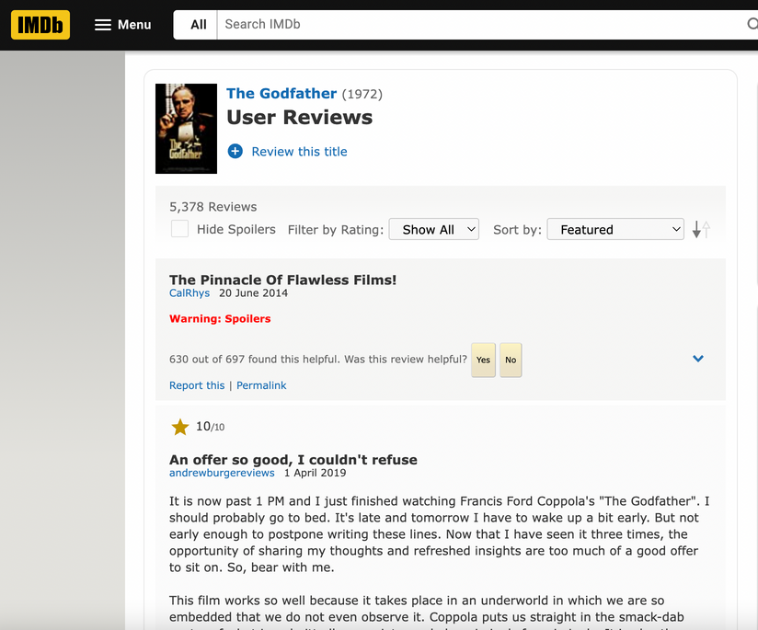

Dataset
IMDB User Review webpage of different movies scraped using ParseHub tool

Slide 6

Real World Application
Overall, the real-world applications of movie reviews data mining projects span from:
improving movie recommendation systems
informing business decisions
enhancing market research efforts
predicting box office performance
managing brand reputation, and
gaining competitive intelligence in the entertainment industry.

Slide 7


Sub Problem - 1
To analyse the text of movie reviews and identify the most important keywords and phrases used to describe the movies using TF-IDF
What is TF-IDF (Term Frequency- Inverse Document Frequency)?
It is a statistical measure that reflects the importance of a term in a document within a collection or corpus.
The tf-idf score for a term is calculated by multiplying its term frequency (how often it appears in a document) by its inverse document frequency (how often it appears in the entire collection of documents).

Slide 8
Solution - TF-IDF
How is it used here?
1. Search: By using TF-IDF to analyze the text of movie reviews, it is possible to create an index of movie titles and associated keywords. This index can be used to quickly search for movies that match a specific set of keywords or phrases.
Rank the documents based on the relevance of the query terms using the TF-IDF scores.
Return the top-ranked documents as search results.
Hence, we can identify the most relevant reviews based on the importance of the query terms in the reviews and the entire collection. This allows for more efficient and accurate search results in the context of movie reviews.

Slide 9

Solution - TF-IDF
How is it used here?
2. Sentiment analysis: By analyzing the TF-IDF scores of words and phrases in movie reviews, it is possible to identify the most positive and negative aspects of movies. This can be used to generate sentiment scores for individual movies or to identify trends in the sentiment of movie reviews over time.

Slide 10

Solution - TF-IDF
How is it used here?
3. Content analysis: By analyzing the TF-IDF scores of words and phrases in movie reviews, it is possible to identify the most common themes and topics that are discussed in reviews. This can be used to categorize movies based on their content or to identify trends in the topics that are most frequently discussed by users.

Slide 11

Solution - TF-IDF
Overall, TF-IDF can be a powerful tool for analyzing the text of movie reviews and gaining insights into user behavior and preferences in a movie-reviewing application.
By identifying the most important words and phrases used to describe movies, it is possible to improve search functionality, perform sentiment analysis, and perform content analysis.

Slide 12

Sub Problem - 2
To develop a movie review similarity search system using Locality-Sensitive Hashing (LSH) with shingling and min hashing techniques. The system aims to identify and retrieve similar movie reviews from a large corpus based on their textual content.
It is a 3-step process :
Shingling: Convert each movie review into a set of shingles.
Min Hashing: Create a signature matrix for each review by applying the min hashing technique.
Locality-Sensitive Hashing (LSH): Implement the LSH algorithm to partition the signature matrix into multiple hash tables.

Slide 13

Solution - LSH
How is it used here?
1. Recommendation: If a user has already watched a movie and liked it, they may be interested in finding other movies with similar themes, characters, or genres. By analyzing the reviews given for a particular movie, it is possible to find other movies that share similar characteristics and recommend them to the user.

Slide 14


Solution - LSH
How is it used here?
2. Analysis: By finding similar reviews for a movie, it is possible to gain insights into the overall reception of the movie. For example, if a large number of reviews mention the same strengths or weaknesses of the movie, it can provide valuable information to filmmakers and critics.

Slide 15

Solution - LSH
How is it used here?
3. Marketing: Similar reviews can be used for marketing purposes as well. If a movie has received positive reviews that highlight a particular aspect of the film (e.g., the acting, the special effects, the storyline), the marketing team can use these reviews in their promotional materials to attract more viewers.

Slide 16

Solution - LSH
How is it used here?
4. User engagement: For movie review websites, finding similar reviews can be a useful way to engage users and keep them on the site for longer. By providing users with recommendations for other movies they may be interested in based on their reviews, it encourages them to explore more content on the website.

Slide 17


Sub Problem - 3
To develop a filtering system using the Bloom filter to identify and eliminate duplicate movie reviews or perform approximate set membership testing.
The system aims to efficiently detect whether a given movie review is already present in a large collection of reviews, thereby reducing redundancy and improving the overall efficiency of review processing.

Slide 18

Solution - Bloom Filtering
How is it used here?
One common use case for Bloom filters in movie review-giving applications is to identify and remove duplicate reviews. In a large database of movie reviews, it is common for multiple users to submit reviews of the same movie, and these duplicate reviews can skew statistical analysis and sentiment analysis of the reviews.

Slide 19



Solution - Bloom Filtering
How is it used here?
By using a Bloom filter to store the hash values of reviews that have already been added to the database, it becomes easy to identify duplicate reviews and prevent them from being added to the database. This can help ensure that the database only contains unique reviews, improving the accuracy of analysis and reducing storage requirements.

Slide 20

Solution - Bloom Filtering
How is it used here?
Another use case for Bloom filters in movie review-giving applications is to perform approximate set membership testing.
For example, a movie review website may want to display the most popular movies based on the number of reviews submitted.
By using a Bloom filter to store the hash values of movie titles that have been reviewed, we can estimate the number of reviews for each movie in constant time and with a small memory footprint.
Reviews

Slide 21


Sub Problem - 4
To apply Market Basket Analysis (MBA) techniques to identify patterns of co-occurrence among movies that are frequently reviewed together by users.
The objective is to uncover associations and dependencies between movies based on user reviews and recommend related movies to enhance user experience and support personalized movie recommendations.

Slide 22

Solution - MBA
What is MBA?
Market basket analysis is a data mining technique that is commonly used in retail and e-commerce to identify patterns of co-occurrence among products that are frequently purchased together. In the context of a movie-reviewing application, market basket analysis could be used to identify patterns of co-occurrence among movies that are frequently reviewed together by users.

Slide 23


Solution - MBA
How is it used here?
For example, by analyzing a large dataset of movie reviews, it may be possible to identify that users who reviewed the movie "The Godfather" also frequently reviewed "The Godfather: Part II" and "Goodfellas". This information could be used to suggest related movies to users who enjoyed "The Godfather", or to inform marketing and advertising campaigns for related movies.

Slide 24

Solution - MBA
How is it used here?
Market basket analysis can also be used to identify user segments based on their preferences. For example, users who frequently review action movies may also be more likely to review science fiction movies. This information could be used to target marketing campaigns and promotions to users who are likely to be interested in specific genres of movies.

Slide 25
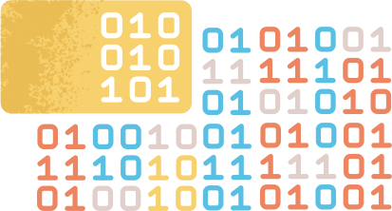
Sub Problem - 5
Using the DGIM algorithm, the system should be capable of processing a continuous stream of reviews and providing approximate counts of positive and negative sentiments within a specified time window.
The DGIM algorithm itself may not be directly applicable to movie review-giving applications, as it is primarily designed for estimating the number of events or occurrences in a continuous data stream.
However, the underlying principles of the algorithm, such as maintaining a sliding window of data and computing aggregates over that window, can be useful in analyzing movie reviews and other types of text data.

Slide 26

Solution - DGIM
How is it used here?
In a movie review-giving application, one could use a sliding window approach to track the sentiment of reviews over time.
For example, by maintaining a sliding window of reviews for a particular movie, and analyzing the sentiment of those reviews, one could estimate how the movie's reception is changing over time. If the sentiment is consistently negative, it may be an indication that the movie is not well-received by audiences, while positive sentiment may indicate a popular or well-regarded movie.

Slide 27
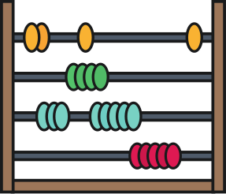


Solution - DGIM
How is it used here?
Count Estimation:
Use the buckets and their counts to estimate the total number of positive sentiments within a specified time window.
The estimation is based on the observation that buckets closer to the present have more weight in the count calculation.
Real-time Sentiment Distribution:
Provide real-time updates of the estimated positive sentiment count and its distribution over time.
Update the counts and distributions as new reviews arrive and old reviews fall outside the time window.

Slide 28

Solution - DGIM
How is it used here?
Additionally, the DGIM algorithm's ability to estimate aggregates over a sliding window could be useful in identifying key themes or topics in movie reviews. By analyzing the text of reviews in a sliding window, one could estimate the prevalence of certain topics or opinions and identify common themes.

Slide 29
Thank You

